Slide 1
Capstone Project: Full Report: Car Accident Severity

Slide 2
Introduction
1. Description & Discussion of the Background Road Accident is the most undesirable and unexpected thing to occur to a road user, though they happen quite often. Unfortunately, we can see a minatory rise of road accidents in United Kingdom, conspicuously highroad accidents over the past few years. It has a massive impact on society as well as in the economy of our country as there is an immense cost of fatalities and injuries. According to a recent report, annually on an average 9,000 lives have been taken by road accidents and lead to almost 28,000 injuries. This record indicates that every day, approximately 28 people were killed by road accidents and it is quite devastating. Besides this, according to WHO, the economic cost of road accidents to a developing country like us is 2-3% of GDP, which is a significant loss for a country like ours. Moreover, reducing this loss has become a great matter of concern for our country now.

Slide 3
Data Description For the accurate prediction of the severity of accidents, a considerable number of traffic accident records with full information is required to train by using the proposed approaches. In this research work, the authors have collected a dataset from the Traffic Bureau that consists of total 37,885 traffic accidents record from the year 2007-2017. The entire dataset will split into two parts- Training Dataset and Test Dataset. 70% of the whole dataset has been chosen randomly by using a python library as a training data set and the remaining 30% has been used as our test dataset. We have used the 70-30 ratio for splitting dataset because of its proven accuracy.

Slide 4
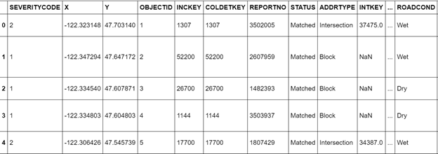
Table 1a: Data Gathering

Slide 5
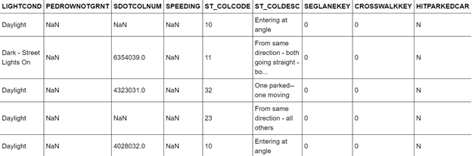
Table 1b: Data Gathering

Slide 6
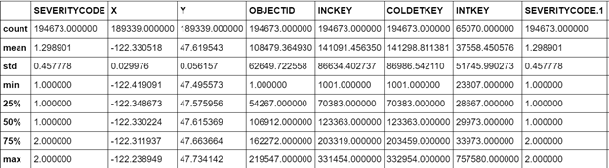
Table 2a: Data Interpolation

Slide 7
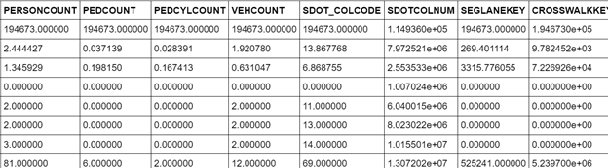
Table 2b: Data Interpolation

Slide 8
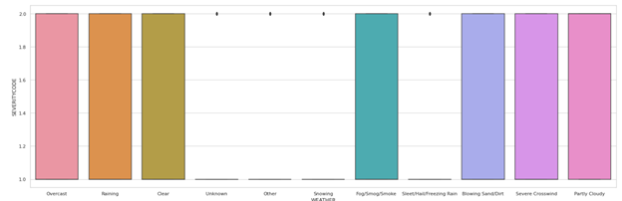
Table 3a: Weather Condition

Slide 9
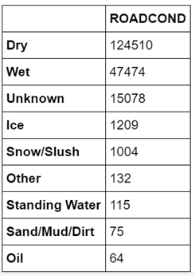
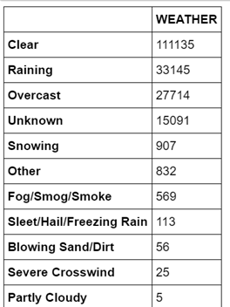
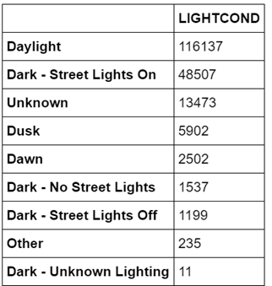
Table : Road Condition
Table : Weather Condition
Table : Light Condition

Slide 10
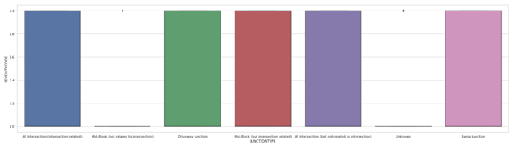
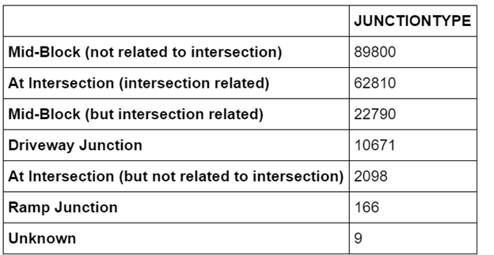
Table : Junction Type
Table : Junction Type

Slide 11
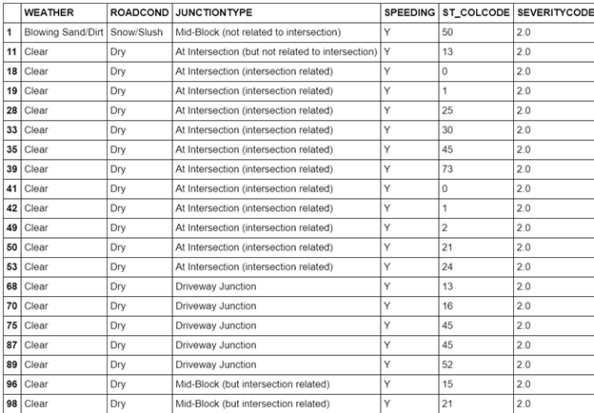
Results In this research paper, I have determined the performance of each algorithm, for four accident severity classes (Fatal / Grievous /Simple Injury/ Motor Collision). By overall performance, Ada-Boost gives the best result because of its iterative classification on matplotlib.
As a result, people are turning to big cities to start a business or work. From the beside table, we can see that severe car accidents occurs frequently under clear and dry condition at intersection. Besides, speeding is also an important factor leading the accident happen.

